Slide 1
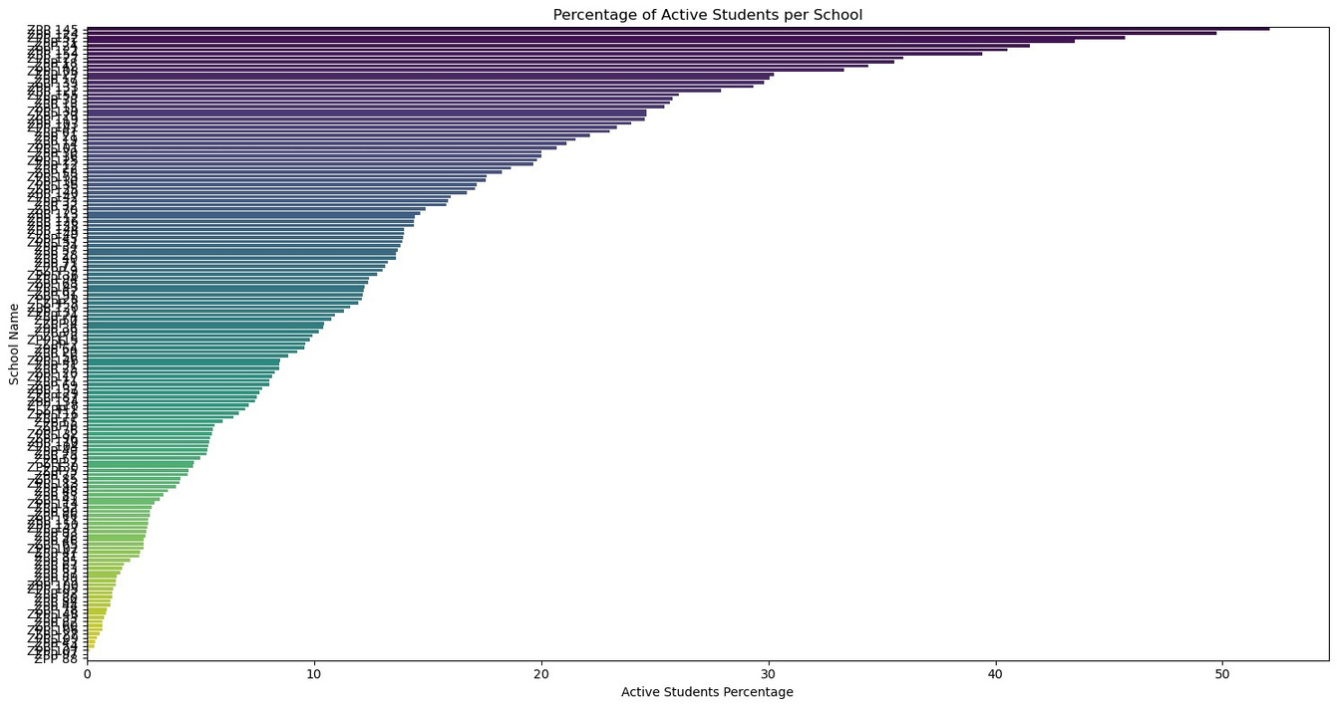
Executive Summary
This report presents a comprehensive analysis of the Khan Academy program implementation across 15 districts, covering 155 schools, and reaching 23,583 students in grades 6-8. The analysis identifies key trends, insights, and recommendations to strengthen the program as it enters its second year in April 2024.
Analysis of Program Reach and Engagement
1. School Level Analysis
The bar plot above visualizes the percentage of active students for each school. This allows us to see which schools have the highest and lowest engagement relative to their total number of registered students.

Slide 2
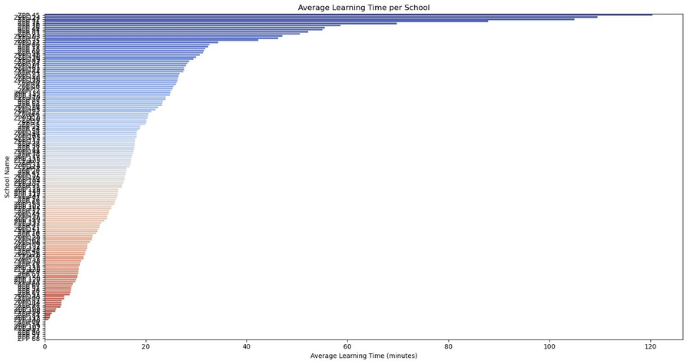
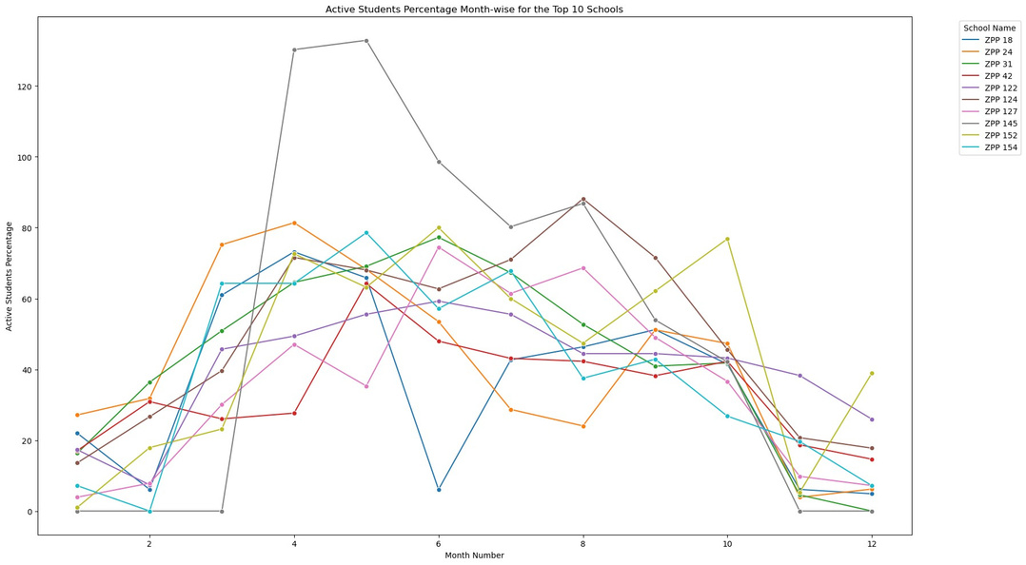
The bar plot below visualizes the average learning time per student for each school. This helps identify schools where students are spending the most and the least time on the platform.
The line plot visualizes the Active Students Percentage across different months for the top 10 schools. Each line represents a school, showing how their engagement fluctuates throughout the year. This allows us to identify patterns and trends in student engagement for these top-performing schools.

Slide 3
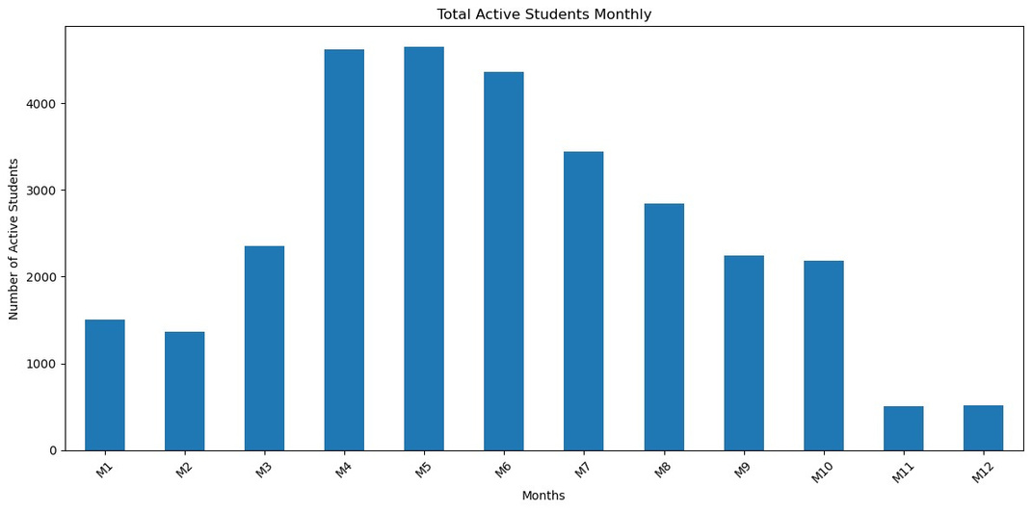
Insight and Inference on Data Discrepancies¶
1. Discrepancies in Active Students Percentage:
● Exceeding100%
: The line plot highlights some schools with Active Students
Percentages exceeding 100%. For example, a school (ZPP 145 ) with 76 registered students shows more than 99 and 101 active students in certain months. Data Inaccuracies: This indicates potential data inaccuracies where the number of active students recorded exceeds the number of registered students.
●
Monthly Active Students and Learning Time
Observation: There is a peak in active students during the fourth and fifth months (April and May), with a noticeable decline towards the end of the year. The average learning time also follows a similar trend, peaking early and gradually declining.
Insight: Engagement levels are highest at the beginning of the academic term and drop towards the end. This suggests a need for strategies to sustain engagement throughout the year.

Slide 4
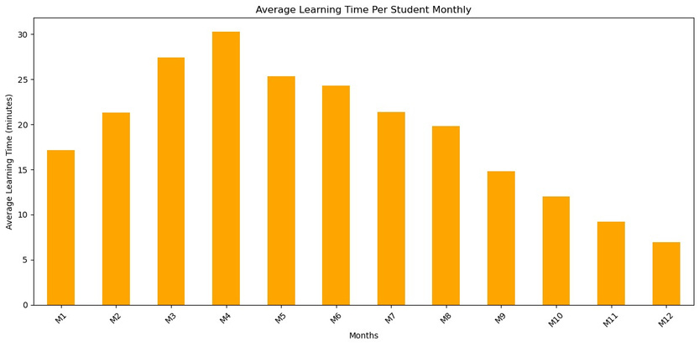
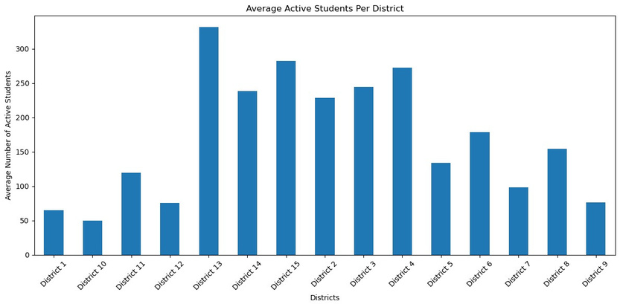
2. District-Level Analysis
Active Students and Learning Time
•
Observation:Districts13,14,and15showhighengagement,whileDistricts9and10
exhibit low engagement. Average learning time also varies, with Districts 5 and 8 showing consistently higher engagement.
•
Insight:High-performingdistrictslikelyhavebetterinfrastructureandmoreeffective
teacher engagement. Low-performing districts may face challenges such as inadequate infrastructure or socio-economic barriers.

Slide 5
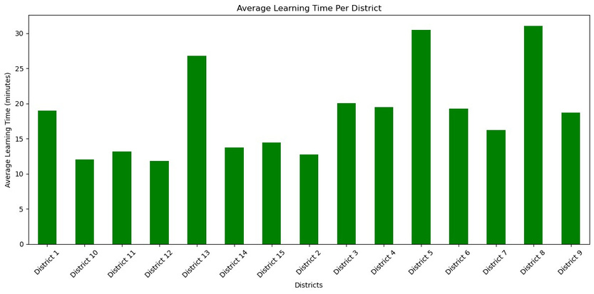
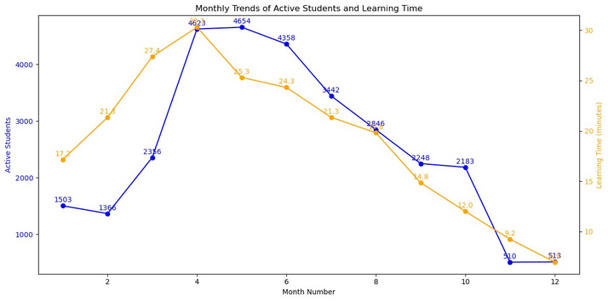
• Observation:Someschoolshaveahighpercentageofactivestudents,whileothersshow significantly lower engagement. • Insight:Schoolswithhigherengagementcanserveasmodelsforbestpractices.Schools with low engagement need targeted interventions to improve performance.
Overall Monthly Trends:
●
The total number of active students shows significant peaks in months 4 and 5, indicating strong engagement during these periods. The average learning time per student also peaks in the early months but declines over time, suggesting initial high engagement that tapers off.
●

Slide 6
2.
:
District-wise Trends
shows consistently high engagement with a relatively stable number of
● District13
active students and learning time, indicating effective program implementation.
● District14and15
also demonstrate high engagement but with more fluctuation,
suggesting variability in student participation or external factors affecting engagement. District 10 and 9 exhibit the lowest engagement, both in terms of active students and learning time, indicating potential challenges in these areas that need addressing.
●
3.
:
Seasonal and External Influences
●
The peaks in engagement around months 4 and 5 could be related to specific academic schedules, such as the start of a new term or preparatory periods for exams. The decline towards the end of the year may coincide with academic fatigue, holidays, or exam seasons reducing student participation.
●

Slide 7
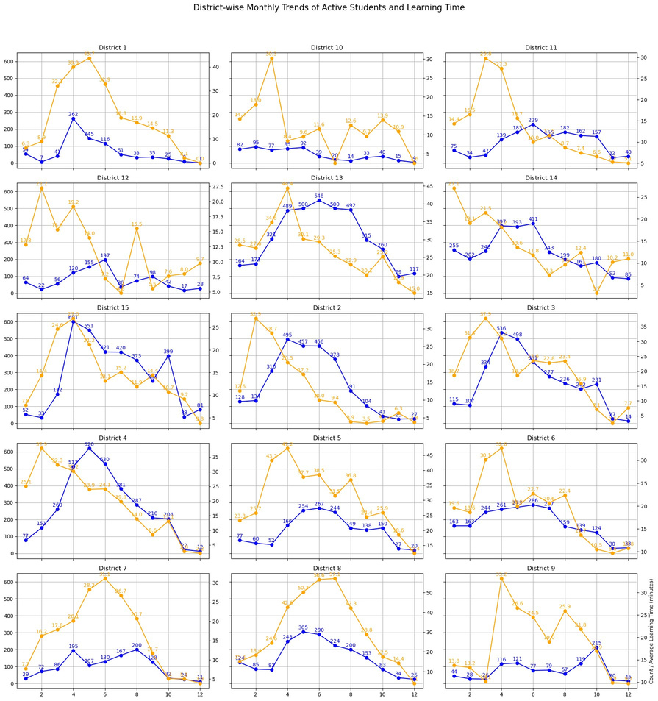
1. Overall Engagement Trends:
●
Peak Engagement: The highest engagement in terms of active students is observed in the fourth and fifth months (April and May). This could be attributed to the start of a new academic term or a focused intervention period. Declining Engagement: There is a noticeable decline in both active students and learning time towards the end of the year. This might be due to academic fatigue, exam periods, or holidays.
●

Slide 8
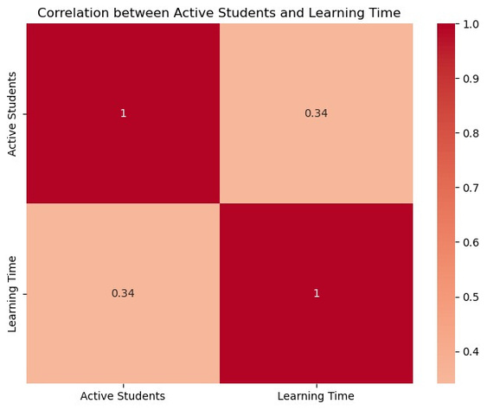
2. Learning Time Consistency:
●
The average learning time per student starts strong but steadily declines over the months. This indicates initial enthusiasm or compliance with the program, which fades over time. Sustained engagement remains a challenge.
3. District-wise Disparities:
● HighEngagementDistricts:Districtslike13,14,and15consistentlyshowhighengagement
in both active students and learning time. These districts likely have better infrastructure, more effective teacher engagement, or other supportive factors.
● LowEngagementDistricts:Districts10and9showsignificantlylowerengagement.These
districts might face challenges such as inadequate infrastructure, less effective teacher training, or socio-economic barriers.
4. Seasonal and External Influences:
●
Peaks in engagement around certain months (April and May) suggest external academic schedules or targeted intervention periods. The decline towards the end of the year aligns with common academic cycles, indicating the need for strategies to maintain engagement during these periods.
1. Correlation Analysis: Heatmap Analysis: The heatmap shows the correlation between the number of active students and the average learning time.

Slide 9
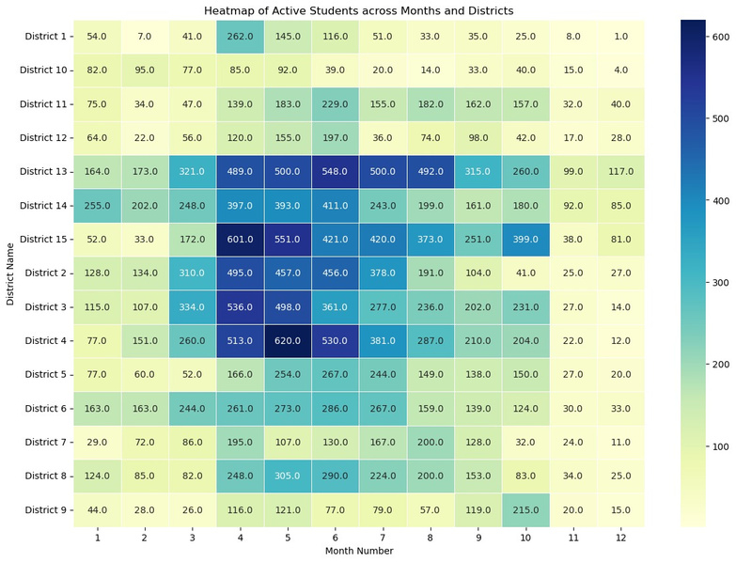
Weak Correlation: The correlation coefficient is close to zero, indicating a weak linear relationship between the two variables. This suggests that simply increasing the number of active students may not directly lead to longer learning times.
2. Heatmap of Active Students:¶ Visualization: The heatmap visualizes the number of active students across different months and districts. High Engagement: Districts 13, 14, and 15 consistently show high numbers of active students across most months, reinforcing their strong engagement. Peak Periods: The concentration of active students in certain months (like April and May) is evident, aligning with earlier observations of peak engagement during these periods.

Slide 10
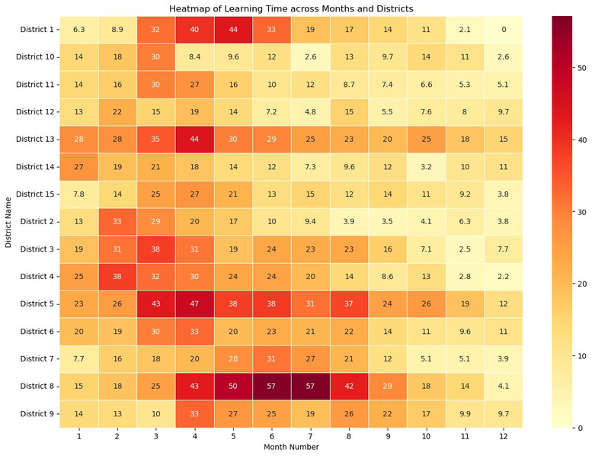
3. Heatmap of Learning Time:¶
● Visualization:Theheatmapvisualizestheaveragelearningtimeacrossdifferentmonthsand
districts.
● EffectiveImplementation:Districtslike5and8showhigheraveragelearningtimes
consistently across months, indicating effective program implementation in these districts.
● Variability:Somedistrictsshowsignificantvariabilityinlearningtime,suggesting
inconsistencies in engagement or external factors affecting usage.
Insights
●
Correlation Insight: The weak correlation between active students and learning time suggests that interventions aimed at increasing student engagement need to focus on both increasing the number of active students and enhancing the quality of engagement to improve learning times.

Slide 11
●
Engagement Consistency: Districts with high engagement (13, 14, 15) and high learning times (5, 8) can serve as models for best practices. Understanding the strategies used in these districts can help in replicating their success in lower-performing areas. Seasonal Patterns: The concentration of active students in specific months highlights the importance of aligning program activities with academic schedules and addressing potential drops in engagement during off-peak periods.
●
Hypotheses Contributing to Observed Patterns
1.
•
Infrastructure Availability: Hypothesis:Schoolswithbetterinfrastructureshowhigherengagementandlonger
learning times.
•
Rationale:Accesstotechnologyandaconducivelearningenvironmentsupport
2.
regular student engagement.
•
Teacher Engagement and Training: Hypothesis:Higherteacherengagementandeffectivetrainingleadtohigherstudent
engagement and longer learning times.
•
Rationale:Well-trainedandmotivatedteachersarecrucialforintegratingdigitaltools
3.
and motivating students.
• •
Socio-Economic Factors: Hypothesis:Socio-economicstatusinfluencesengagementlevelsonKhanAcademy. Rationale:Economicbarriersmaylimitstudents’accesstodevicesandinternetat
4.
home.
Seasonal and Academic Cycles: Hypothesis:Engagementlevelsfluctuatewithacademiccyclesandseasonalfactors. Rationale:Examperiodsandholidayssignificantlyimpactstudentactivity. Data Recording and Quality: Hypothesis:Inaccuraciesindatarecordingcontributetoanomaliesinengagement
• •
5.
•
metrics.
•
Rationale:Ensuringdataintegrityisfundamentalforreliableanalysisandinsights.
Recommendations for Strengthening Implementation in the Second Year
For Yourself (M&E Analyst):
1.
•
Data Quality Assurance: Implementregulardataauditsandautomatedvalidationtoensureaccurateand
consistent data recording.
•
Identifyandcorrectanydiscrepancies,suchasactivestudentsexceedingregistered
2.
students.
Granular Data Analysis: Conductdetailedschool-levelanalysistoidentifyspecificbarriersandsuccess
•
factors.
•
Segmentschoolsanddistrictsbasedonperformancetotailorinterventionsand
3.
support.
Feedback Mechanisms: Developcomprehensivereportshighlightingkeymetricsandtrendsforstakeholders. Establishafeedbackloopwithschoolsandteacherstosharefindingsand
• •
collaboratively address challenges.

Slide 12
For State Officials:
1.
•
InfrastructureInvestment: Prioritizeresourceallocationtolow-performingdistrictstoensuretheyhavethe
necessary infrastructure (computers, internet access) to support Khan Academy usage. Fosterpartnershipswithprivateorganizationstosecureadditionalfundingand
•
2.
resources for infrastructure improvements.
•
PolicySupport: AdvocatefortheintegrationofKhanAcademyintotheregularschoolcurriculum,
ensuring consistent use.
•
Implementincentiveprogramstorewardschoolsandteacherswhoshowsignificant
3.
improvement in engagement and learning outcomes.
•
AddressingSocio-EconomicBarriers: Developprogramstoprovidedevicesandinternetaccesstostudentsfrom
low-income families.
•
Engagewithcommunityorganizationstosupportstudents’learningneedsoutsideof
For Teachers:
school.
1.
•
EnhancedTrainingandSupport: Providecontinuousprofessionaldevelopmentopportunitiesfocusingoneffectiveuse
of Khan Academy, integrating it with classroom teaching, and tracking student progress. Establishpeerlearningnetworkswhereteacherscansharebestpracticesand
•
2.
strategies for increasing student engagement.
•
StudentEngagementStrategies: Implementmotivationalstrategiessuchasgamification,rewards,andrecognitionto
encourage regular use of Khan Academy.
•
Encourageteacherstomonitorstudentprogressregularlyandprovidetimely
3.
feedback to keep students engaged and on track.
•
CustomizedLearningPlans: Helpteacherscreatepersonalizedlearningplansforstudents,usingKhan
Academy’s tools to address individual learning gaps.
•
Encourageflexibleusagemodels,suchasincorporatingKhanAcademyinboth
classroom settings and home assignments.
Conclusion
This comprehensive analysis identifies key trends, insights, and recommendations to strengthen the Khan Academy program as it enters its second year. By focusing on data quality, infrastructure investment, policy support, teacher training, and student engagement strategies, the program can achieve more consistent and sustained usage, ultimately improving learning outcomes for all students.

